Slide 1
Analog quantum simulation of PDEs
Focusing on mathematical Ideas
Tianhao HU
Oct 2023

Slide 2
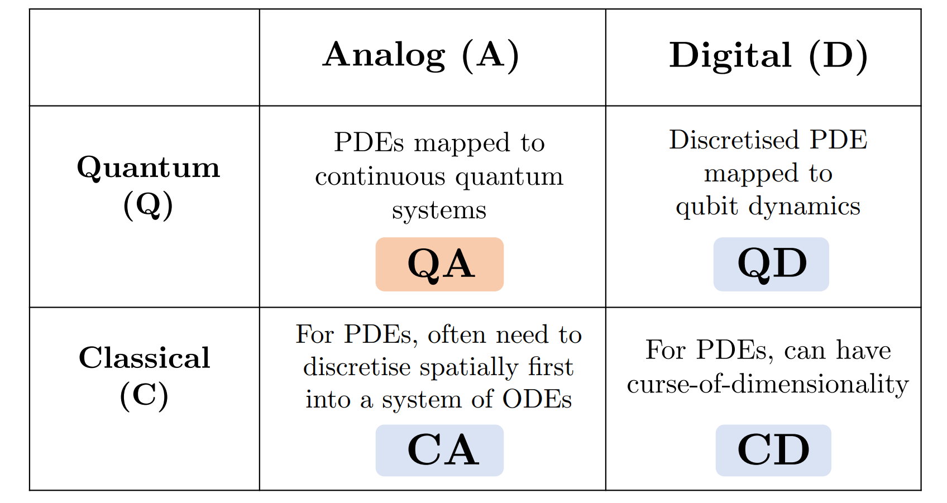
Overview of solving PDEs

Slide 3
What is the element of continuous quatumn system?
Qubit:
A qubit uses the eigenbasis {|0⟩, |1⟩} for the computational basis.
Qumode:
A qumode uses the eigenbasis {|x⟩}_{x∈R} for the computational basis.

Slide 4






Basic mathematical setups
The quadrature operators of a qumode are and
Relations
With creation and annihiliation operators

Slide 5







Important Formula

Slide 6




Slide 7
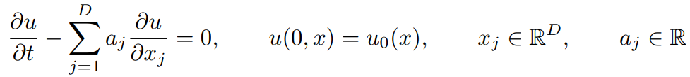

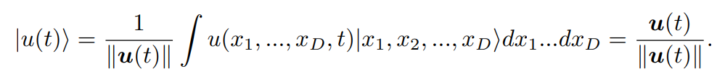
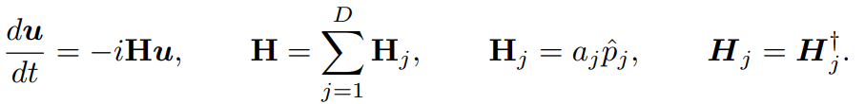
Linear Convection Equation
Problem:
Definition:
Governing Equation becomes:

Slide 8
Linear Convection Equation
Solving it gives:
Reason why the example is easy:
Behavior in each dimension is independent of each other
u evolves via a unitary operation exp(−iHt),

Slide 9
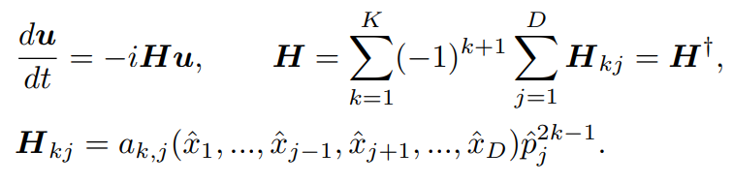
Higher Order in Space with some Conditions in Parameter
Problem:
Similarly,

Slide 10
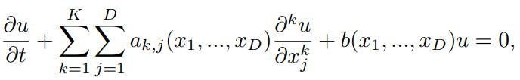

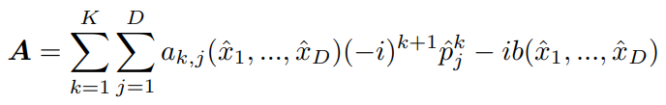
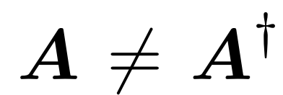
General Case and Solution--- Schrodingerisation methods
Problem:
Following our past method:
Note that,

Slide 11



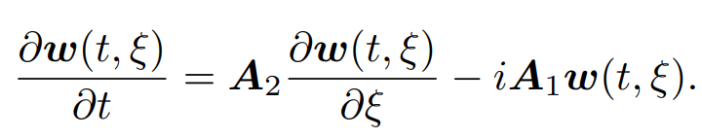
Schrodingerisation methods
Note that for a non-Hermitian matrix A, there are two other Hermitian matrix closely related to A. They are,
The way we solve it is called Schrodingerisation.
We assume
Then the previous governing equation becomes

Slide 12
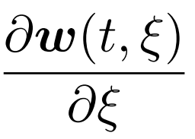
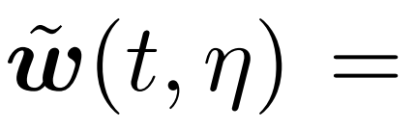
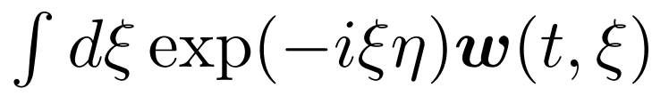
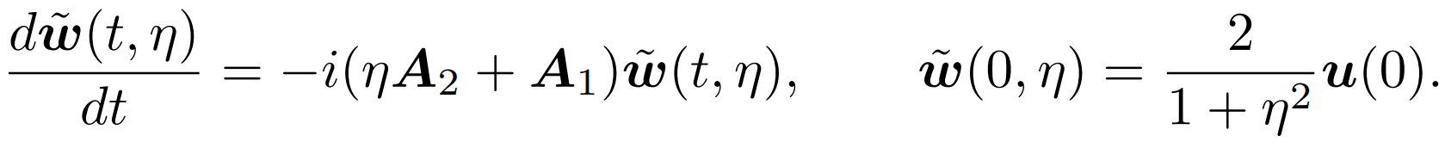
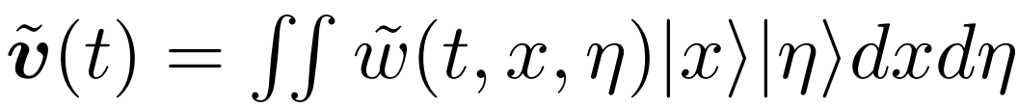
Schrodingerisation methods
Still we get the unsatisfactory term,
We use Fourier Transformation to solve that.
Then we have
But we have introduce in another parameter η. So we need

Slide 13
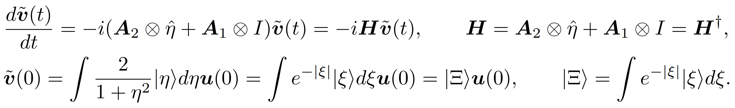
Schrodingerisation methods
Similarly,
In summary, the Hamiltonian is expressed as,

Slide 14
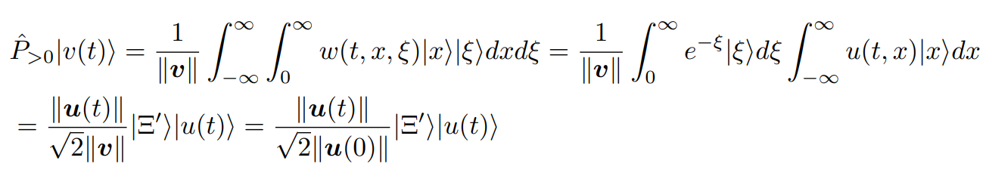


Retrieve solution from simulation
perform an inverse quantum Fourier transform (continuous) on |v˜(t)⟩ to retrieve |v(t)⟩
Thus the probability of retrieving the state |Ξ⟩|u(t)⟩ after the projective measurement Pˆ>0 is given by

Slide 15
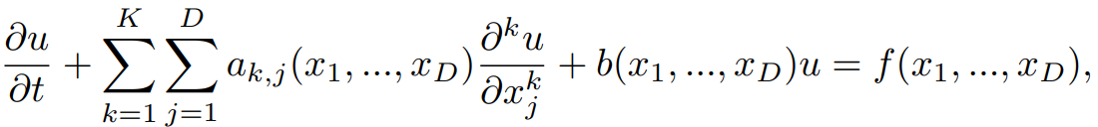
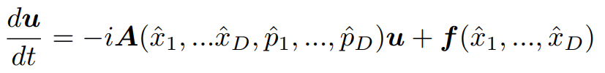
Inhomogeneous PDE
Key Idea: Combining the source and the solution into one vector.
Following the similar way to derive the next equation,

Slide 16

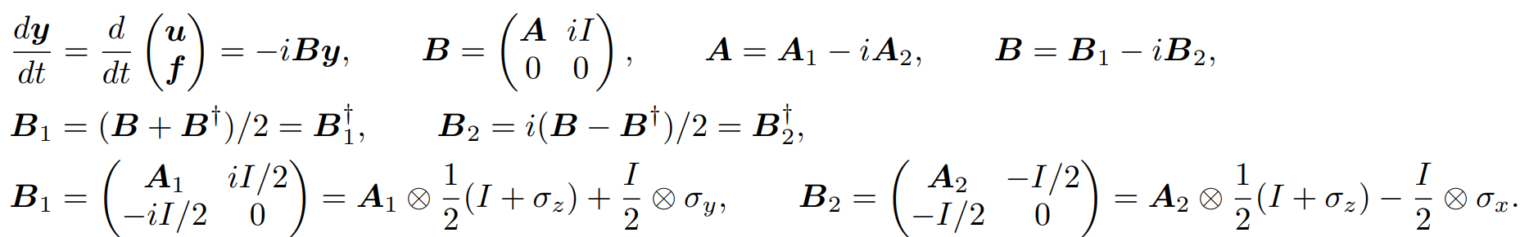
Inhomogeneous PDE
How to combine: only add another qubit instead of qumode. Dilating the system
Then we have,
It can be solved via Schrodingerisation.

Slide 17
PDE with higher-order derivatives in t
Key Idea: Solving it like what we do in higher order ODEs.
Dilate the system,

Slide 18
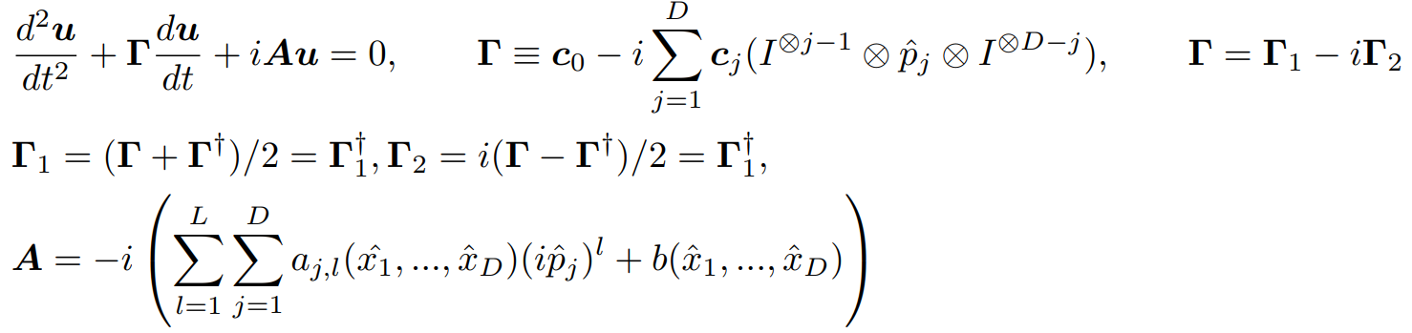
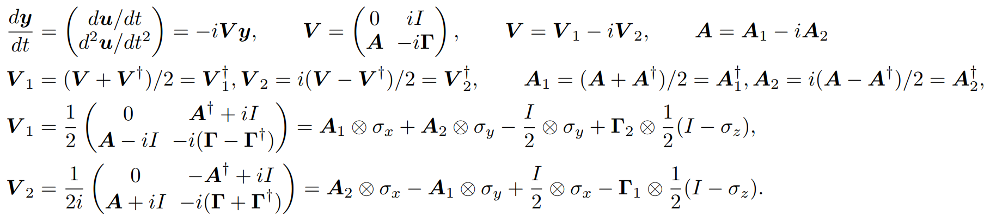
PDE with higher-order derivatives in t
Details:

Slide 19
PDEs with Uncertainty
Key idea: Galerkin projection.
Our u isa derived via integrate variables with uncertainty.

Slide 20
PDEs with Uncertainty
To derive P, we can identify bold n to be particle numbers, and associate z with a quadrature value, like position eigenvalues. So

Slide 21
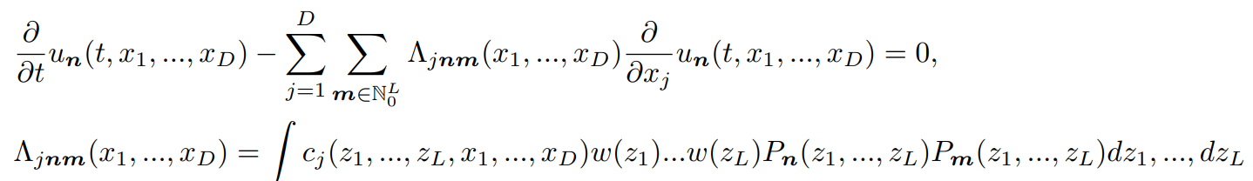
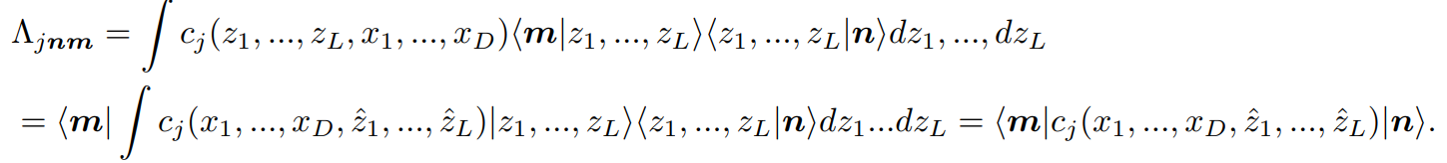
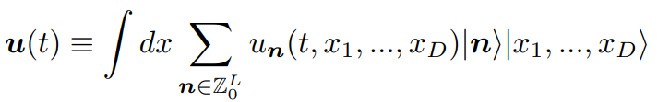
PDEs with Uncertainty
Details

Slide 22

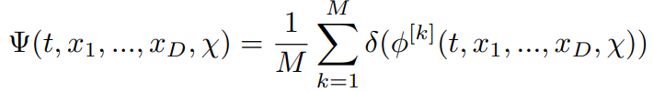
Nonlinear PDEs
Key idea: level set method to turn into linear PDEs
Introduce a level set function
Then defining X = (x1, ..., xD, χ), aj = Fj (χ) for j = 1, ..., D and aD+1 = −Q(x1, ..., xD, χ)

Slide 23
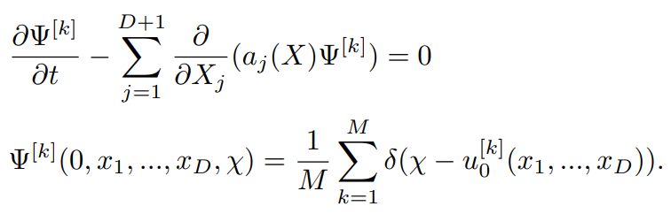

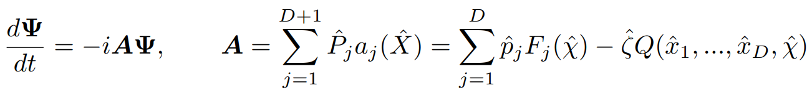

Nonlinear PDEs
Denote
Notice that we still have the term,
What should we do?

